Slide 1
The Battle of Neighborhoods
AUSTIN TEXAS: DETERMINING THE LOCATION OF A RESTAURANT BUSINESS

Slide 2
Introduction, Problem Description and Background
There are several important factors to consider in making the decision on where to locate a restaurant business, having in mind that location can affect cost and profit, and also taking note of the fact that profit maximization is the primary goal of most businesses.

Slide 3
Introduction, Problem Description and Background
It is important to undertake a surrounding business and competitor analysis in determining the location of the business. Are businesses in the area doing well? Are people and businesses in the area affluent? What is the average income of people in the area? What types of restaurants are in the area? If, for example, there are already six barbeque restaurants in the neighborhood, it may not make business sense to establish another in the neighborhood.

Slide 4
Introduction, Problem Description and Background
If there is a night club in the neighborhood it might be expedient to situate a restaurant that caters for after hour crowd, after they are done with night drinking and clubbing.
Visibility and accessibility are also vital considerations; one would want not a location in a side street with very little foot traffic and one would prefer a location accessible to car traffic, parking space should, for instance be available.
What about the cost of the space? Is it affordable? Will it sustain or consume profit? Is there enough space to accommodate your vision?

Slide 5
Introduction, Problem Description and Background
What is the crime rate in the neighborhood? You would not want crime to chase away your customers. What is the population density of the neighborhood?. What are the demographics in terms of age, gender, employment, unemployment, underemployment, income bracket? How accessible are the sources of food supply?
These questions and considerations are within the purview of location data and other data sources to answer. This is precisely what this project is about, using data to analyze, provide insight and provide solution.
I chose Austin, Texas, USA as the location to base the analysis of this project. The choice is informed by the fact that Austin, Texas was ranked as the 2019 best city in the USA to live in, according to U.S. News & World Report’s 125 Best Places to Live in the USA.

Slide 6
Introduction, Problem Description and Background
Target Audience
This project is for investors who are looking for prospects to invest in, particularly for entrepreneurs who want to invest in restaurant business in the United States of America but are curious of where best to locate it. The information here, though targeted at restaurant business are also useful for other businesses.
Startups would find this information also invaluable.
Data scientist, particularly beginners will gain insights into real world application of data science.

Slide 7
Data Description and Methodology
1. The major dataset used for this project is sourced from 'https://data.austintexas.gov/Building-and-Development/Neighborhood-Reporting-Areas-Zoning-Acres/npuf-crwm'
2. Google maps is used to derive the latitude and longitude coordinates of the Neighborhoods in Austin, Texas.
3. The Foursquare API was used to provide location data of venues and allied information in the neighborhoods.

Slide 8
Data Description and Methodology
This project uses an unsupervised learning approach, which uses data to identify patterns and information about major trends in the very dynamic restaurant industry in Austin neighborhoods, this is with a view to also provide insight into some atypical behaviors that are unique to Austin restaurant business; which are more evident in view of the new realities introduced by the Covid-19 pandemic.

Slide 9
Data Description and Methodology
The K-means analytic clustering algorithm will be used to segment restaurants into clusters with a view to identifying the best clusters to locate what type of restaurant as prescribed by the analysis.

Slide 10
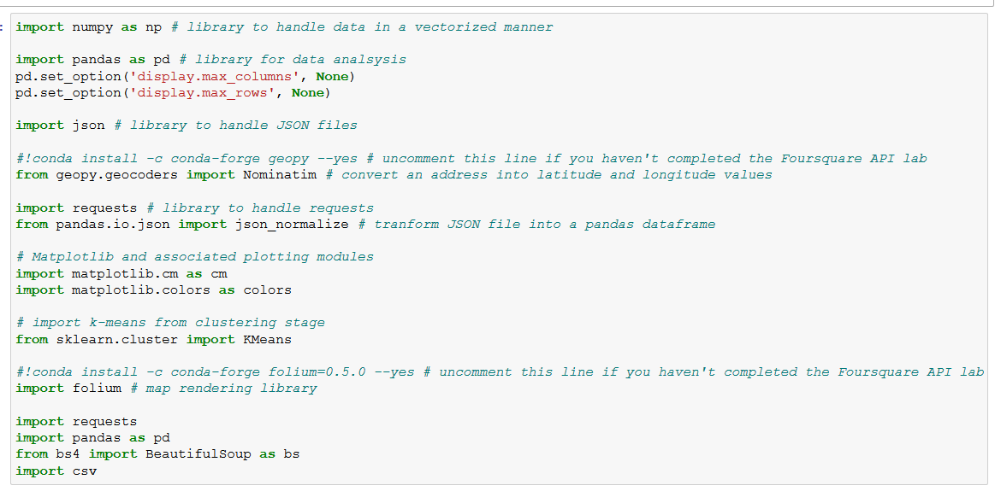
Import Libraries

Slide 11
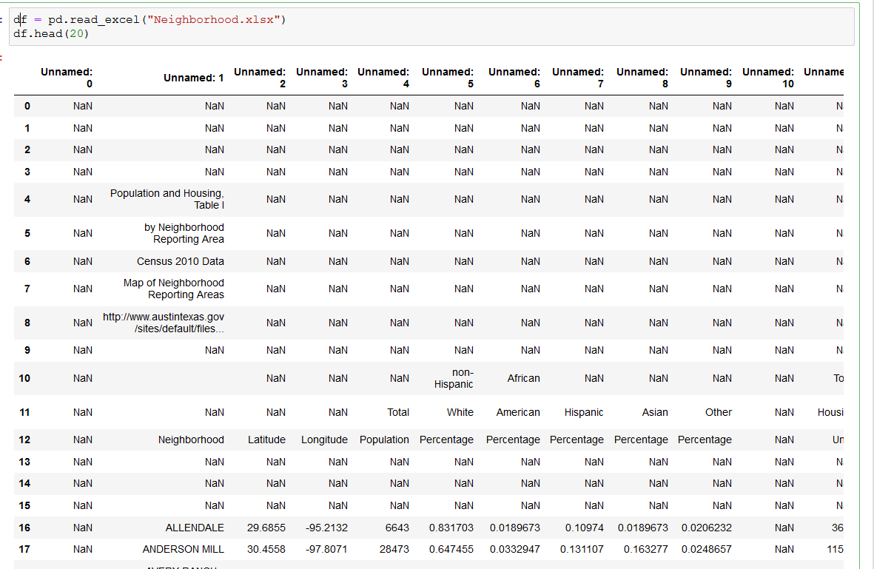
Read Austin Neighborhood Dataset

Slide 12
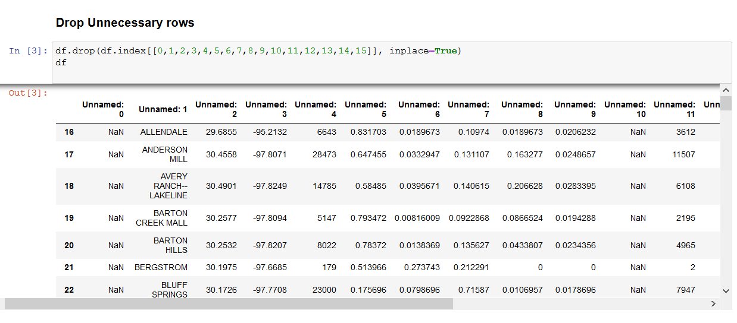
DATA WRANGLING

Slide 13
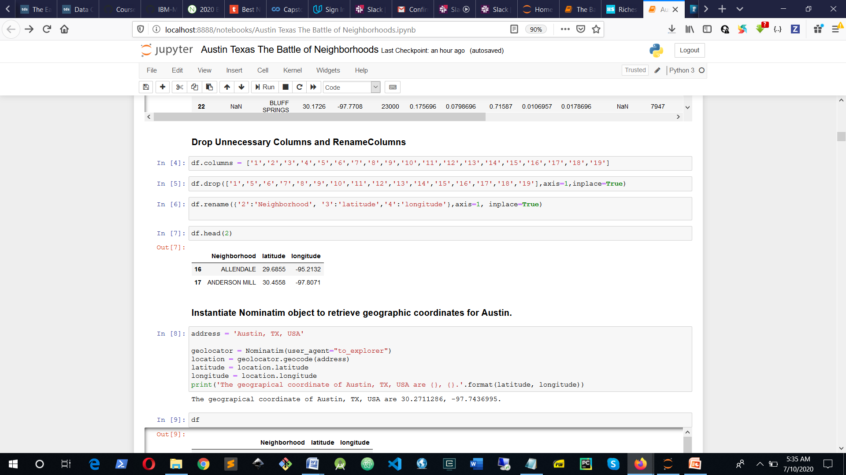
DATA WRANGLING

Slide 14
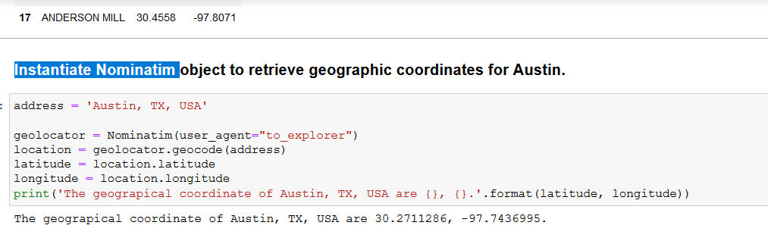
Instantiate Nominatim

Slide 15
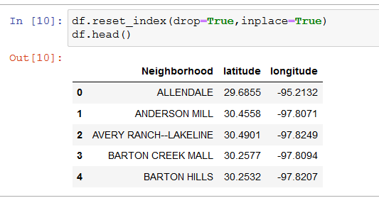
Reset Dataframe Index

Slide 16
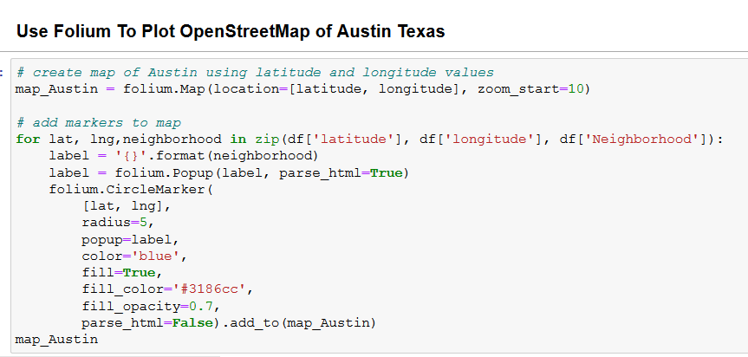
Use Folium To Plot OpenStreetMap of Austin Texas

Slide 17
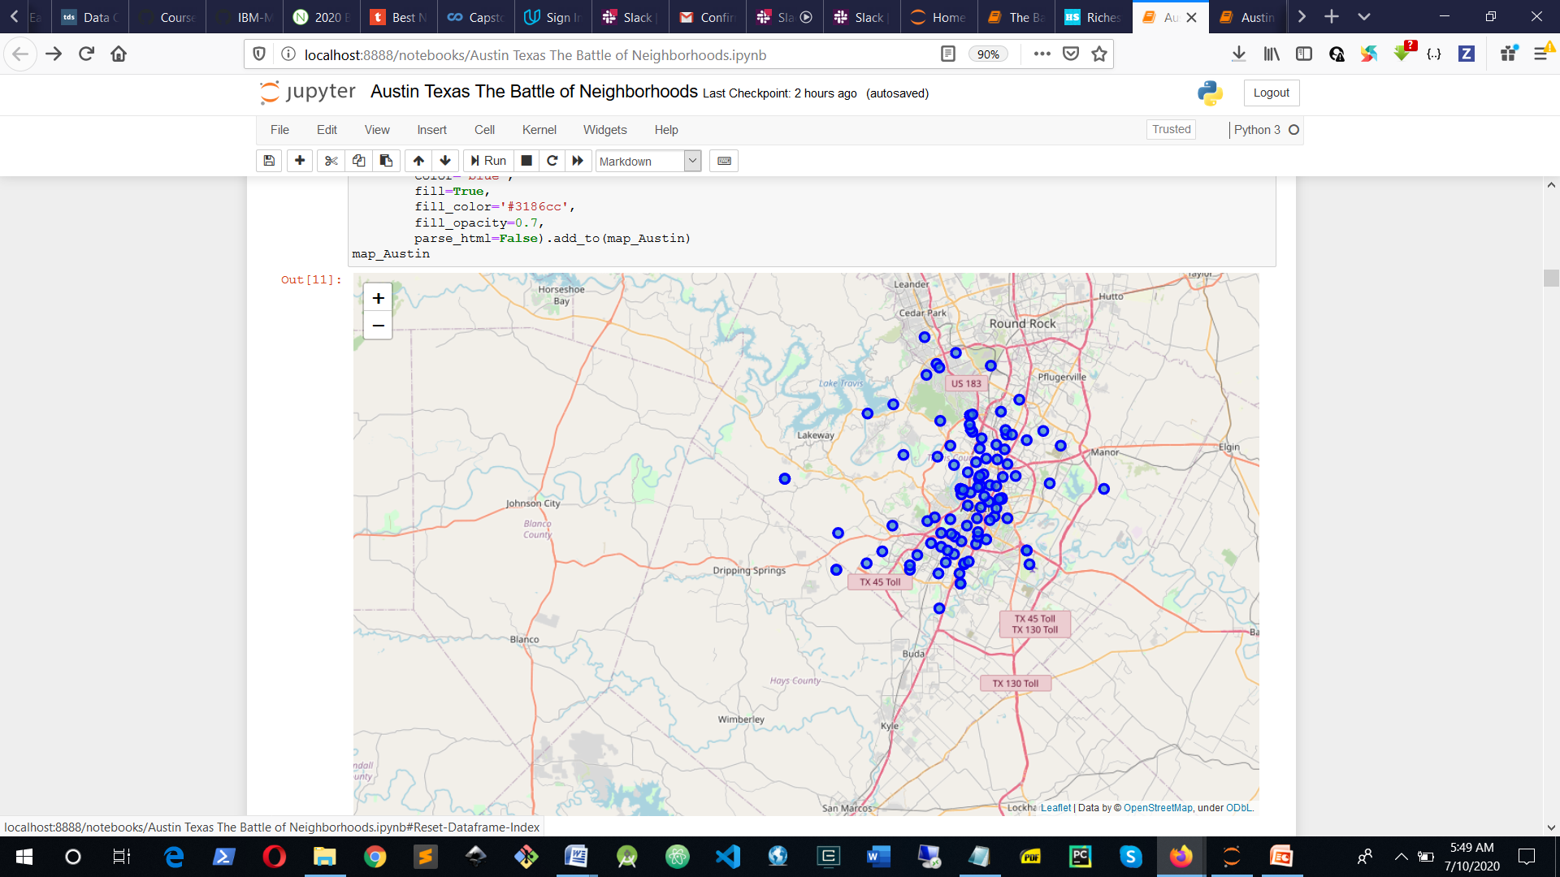

Slide 18
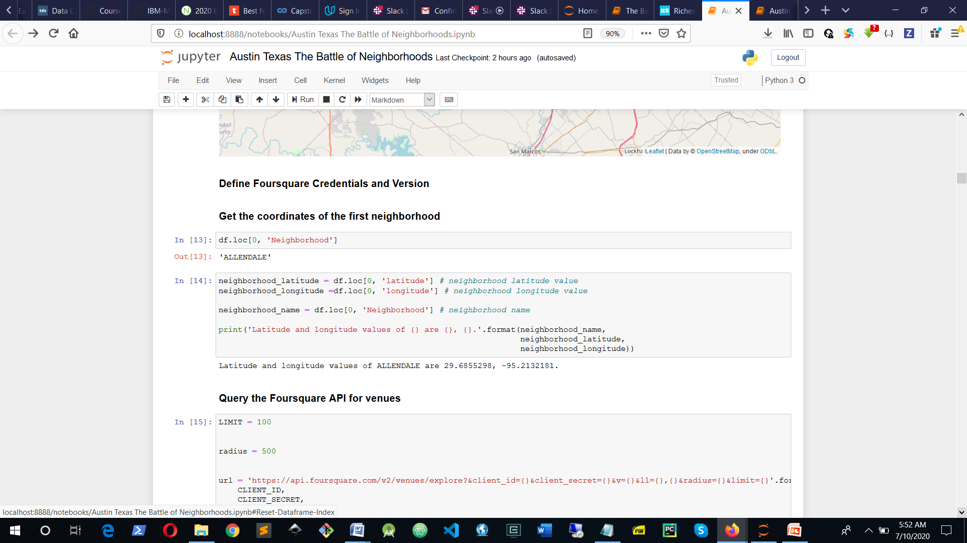

Slide 19
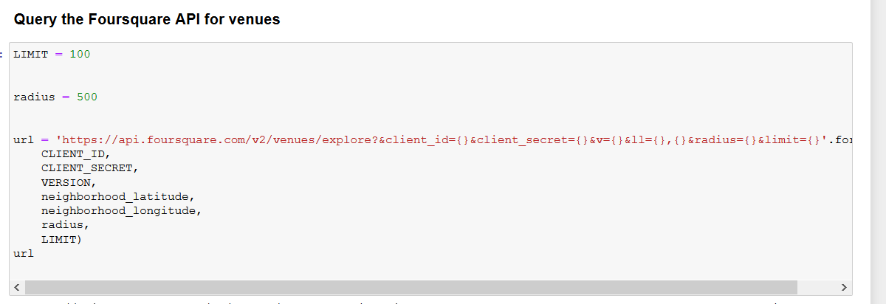

Slide 20
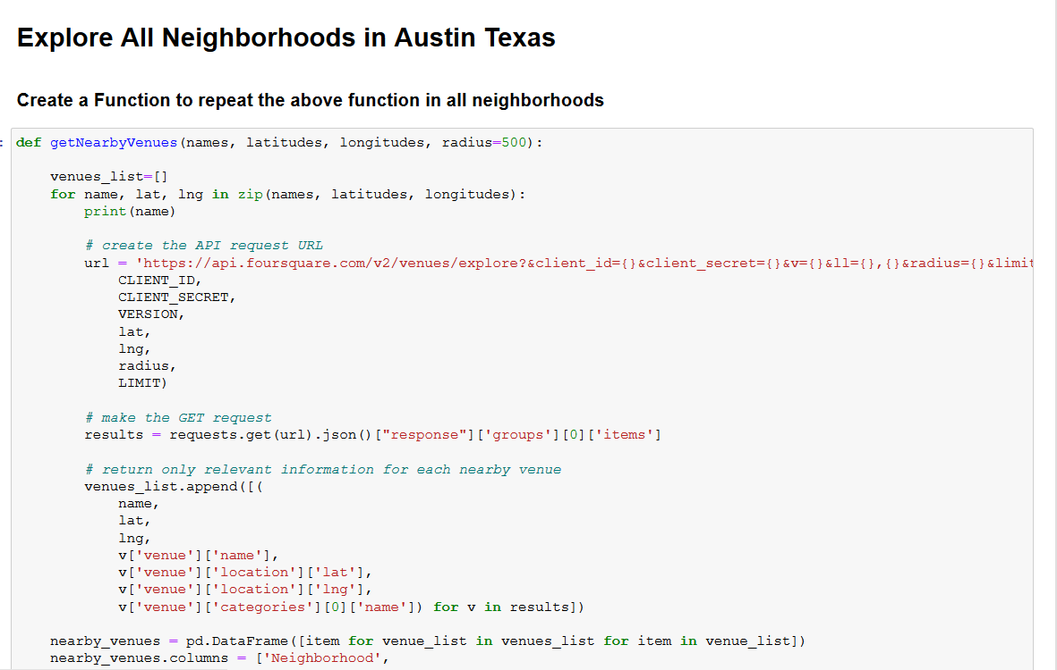

Slide 21
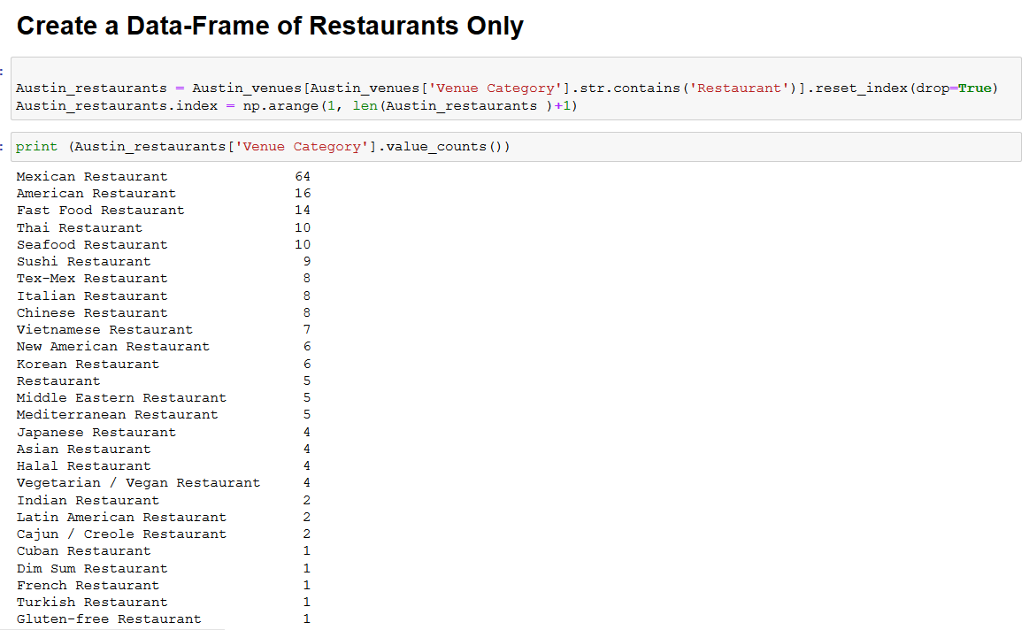

Slide 22
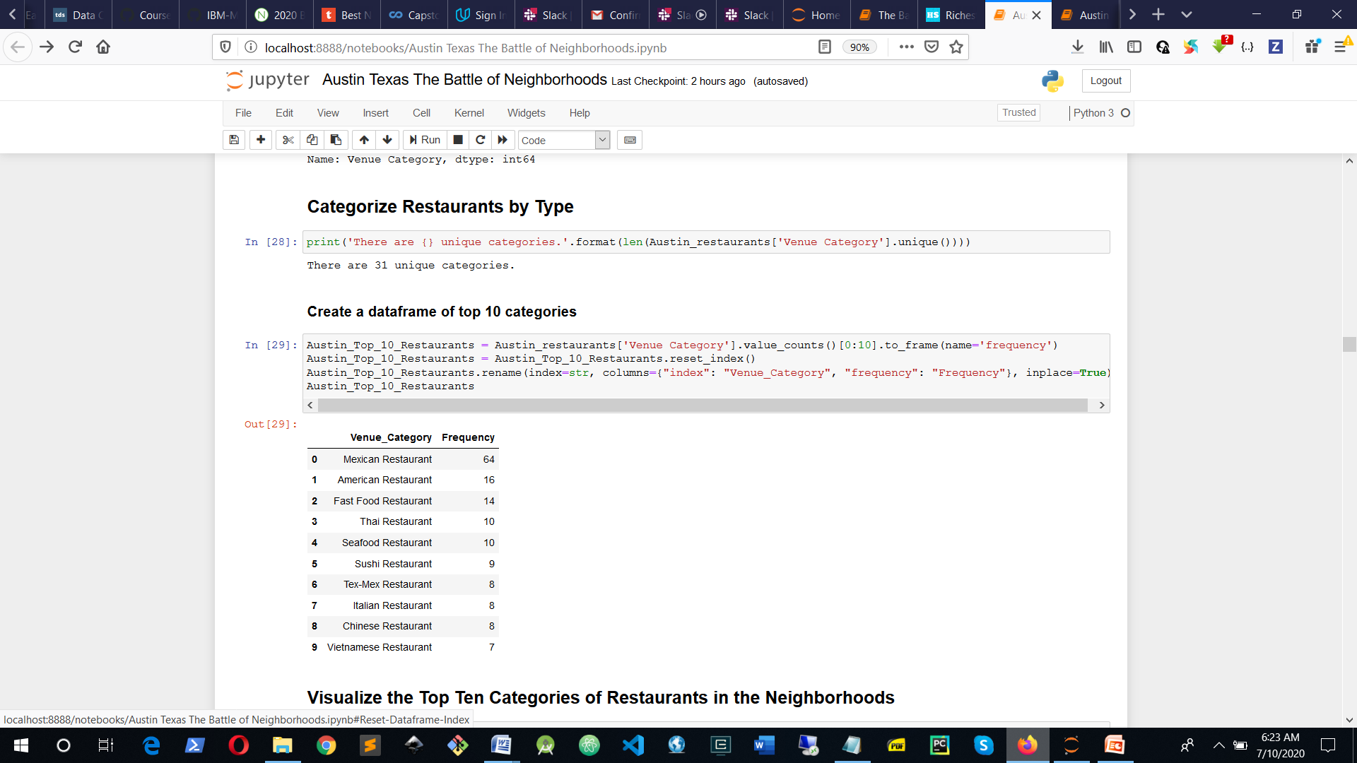

Slide 23
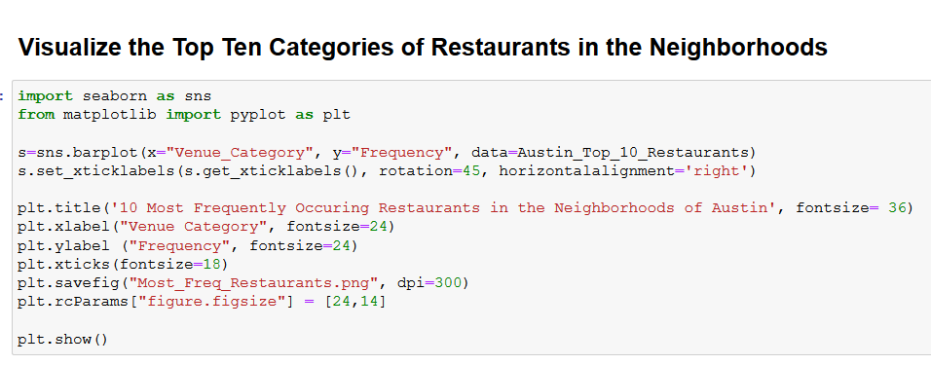

Slide 24
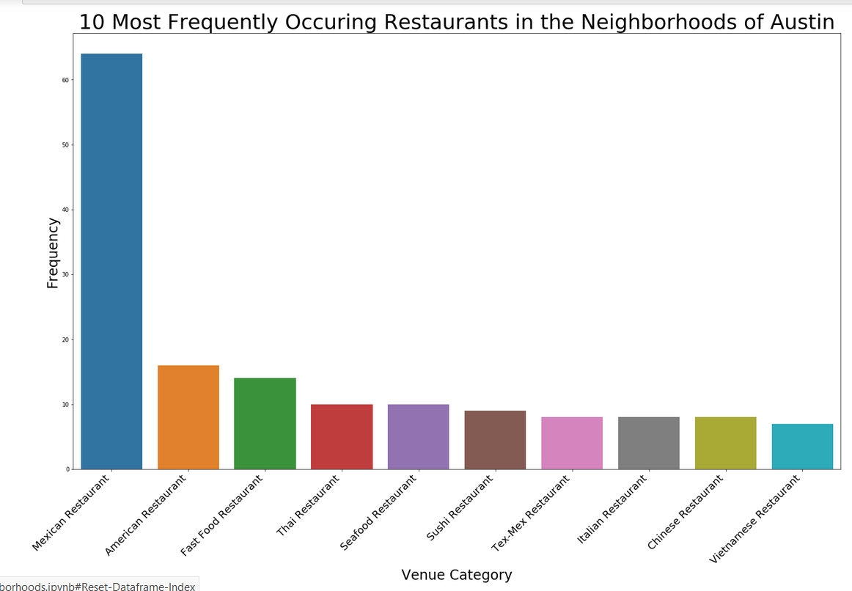

Slide 25
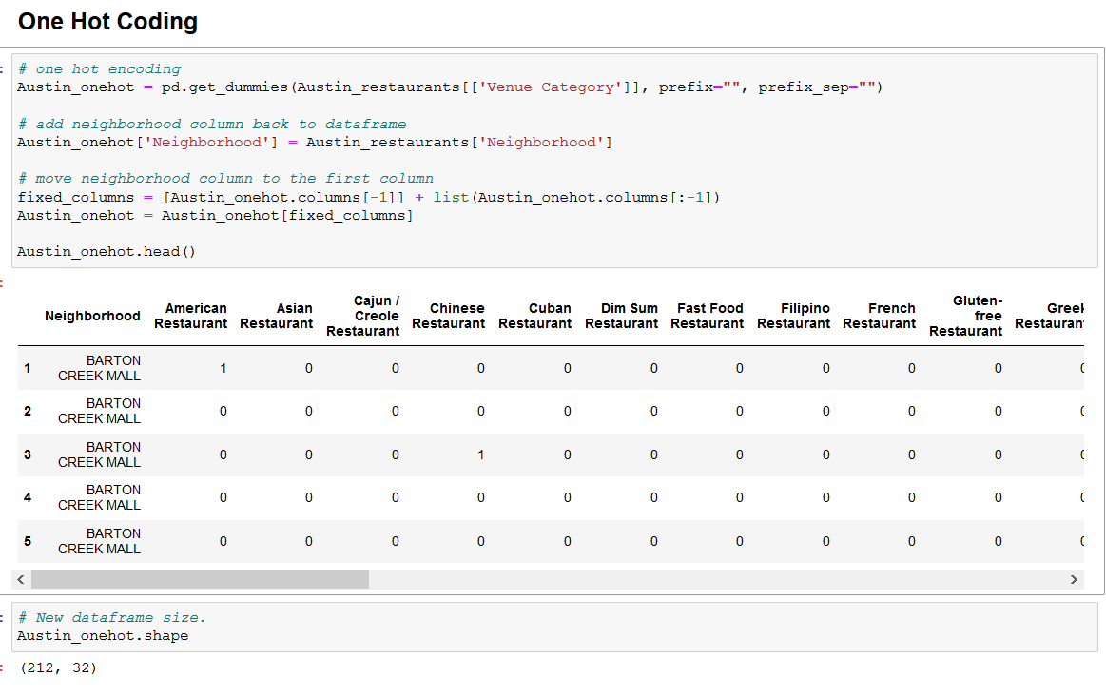

Slide 26
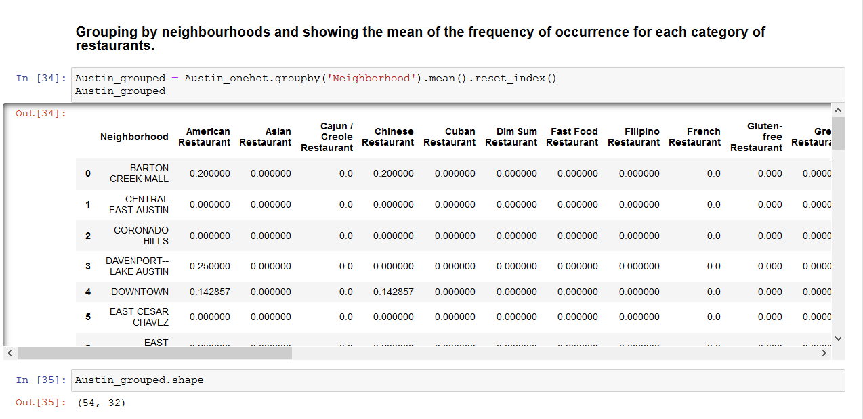

Slide 27
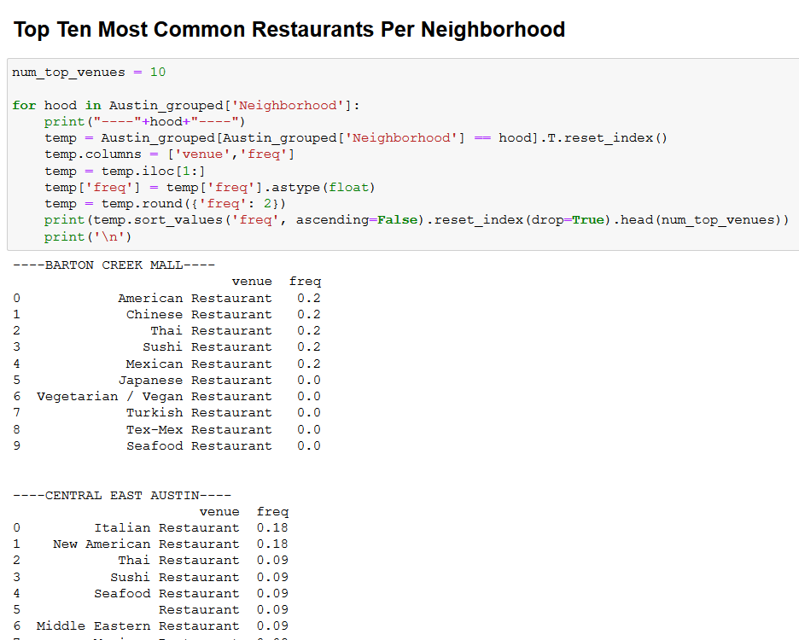

Slide 28
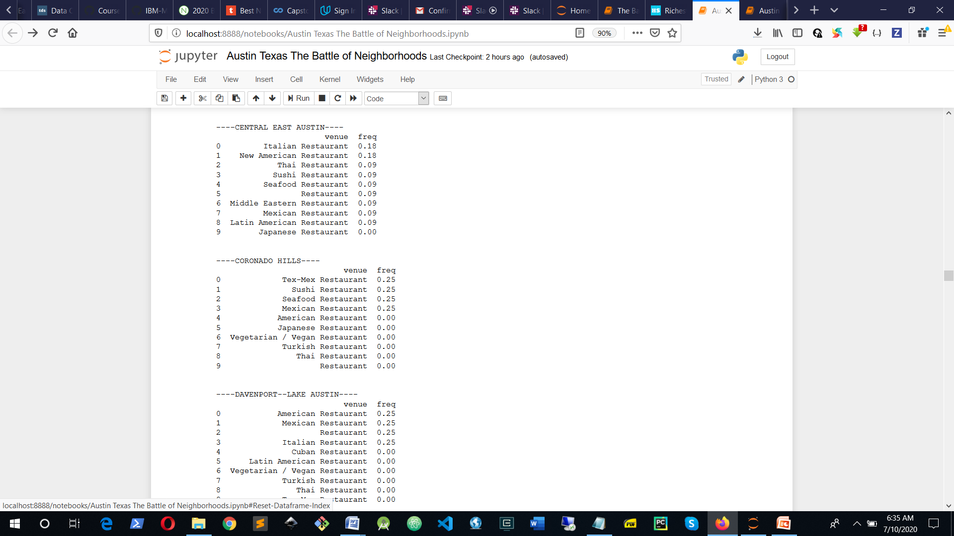

Slide 29
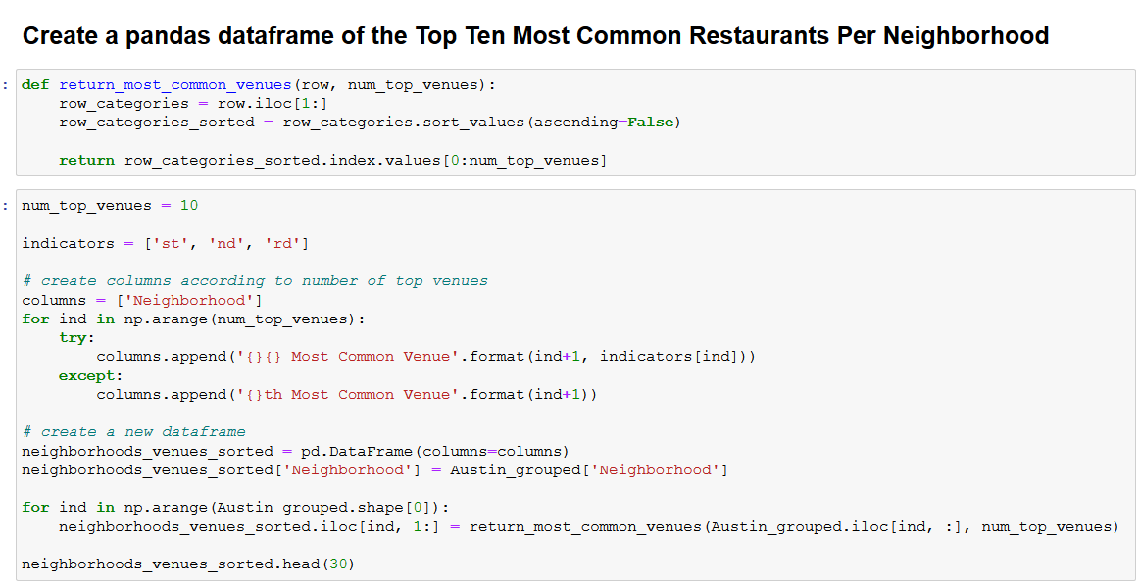

Slide 30
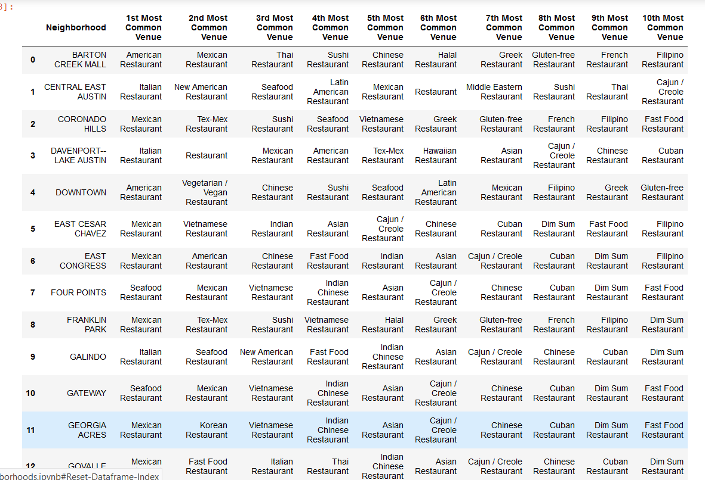

Slide 31
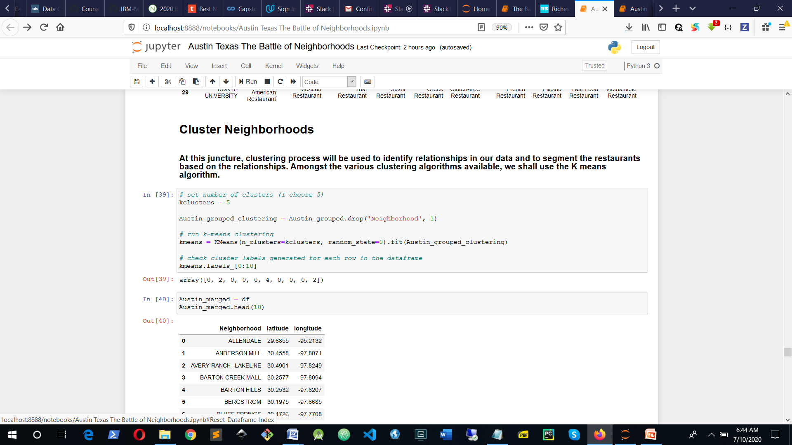

Slide 32
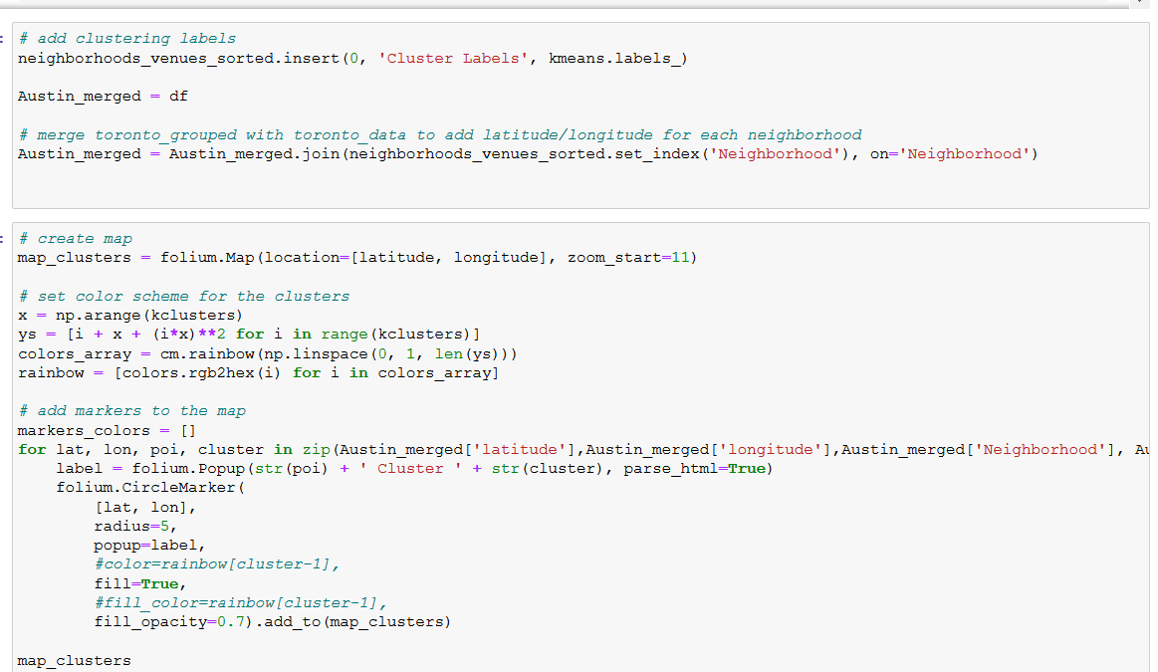
Visualize Clusters

Slide 33
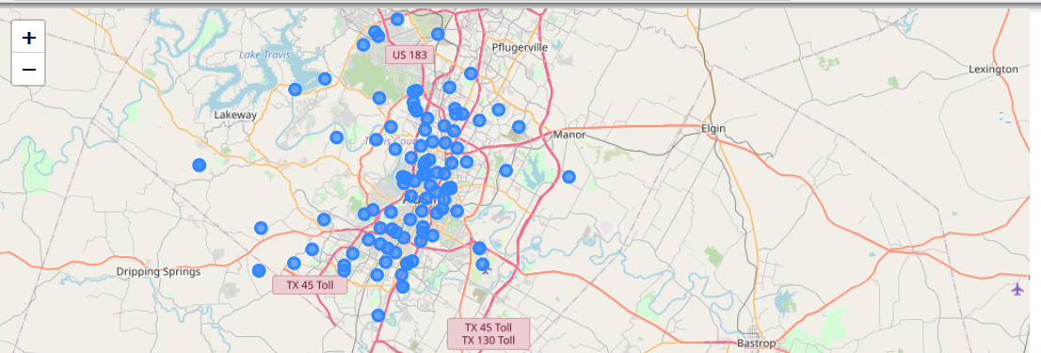
Visualize Clusters

Slide 34
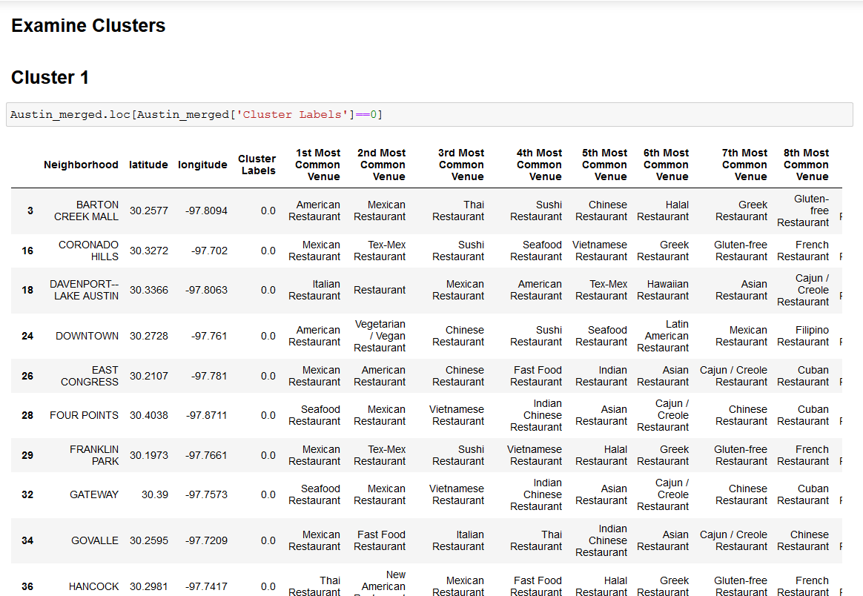

Slide 35
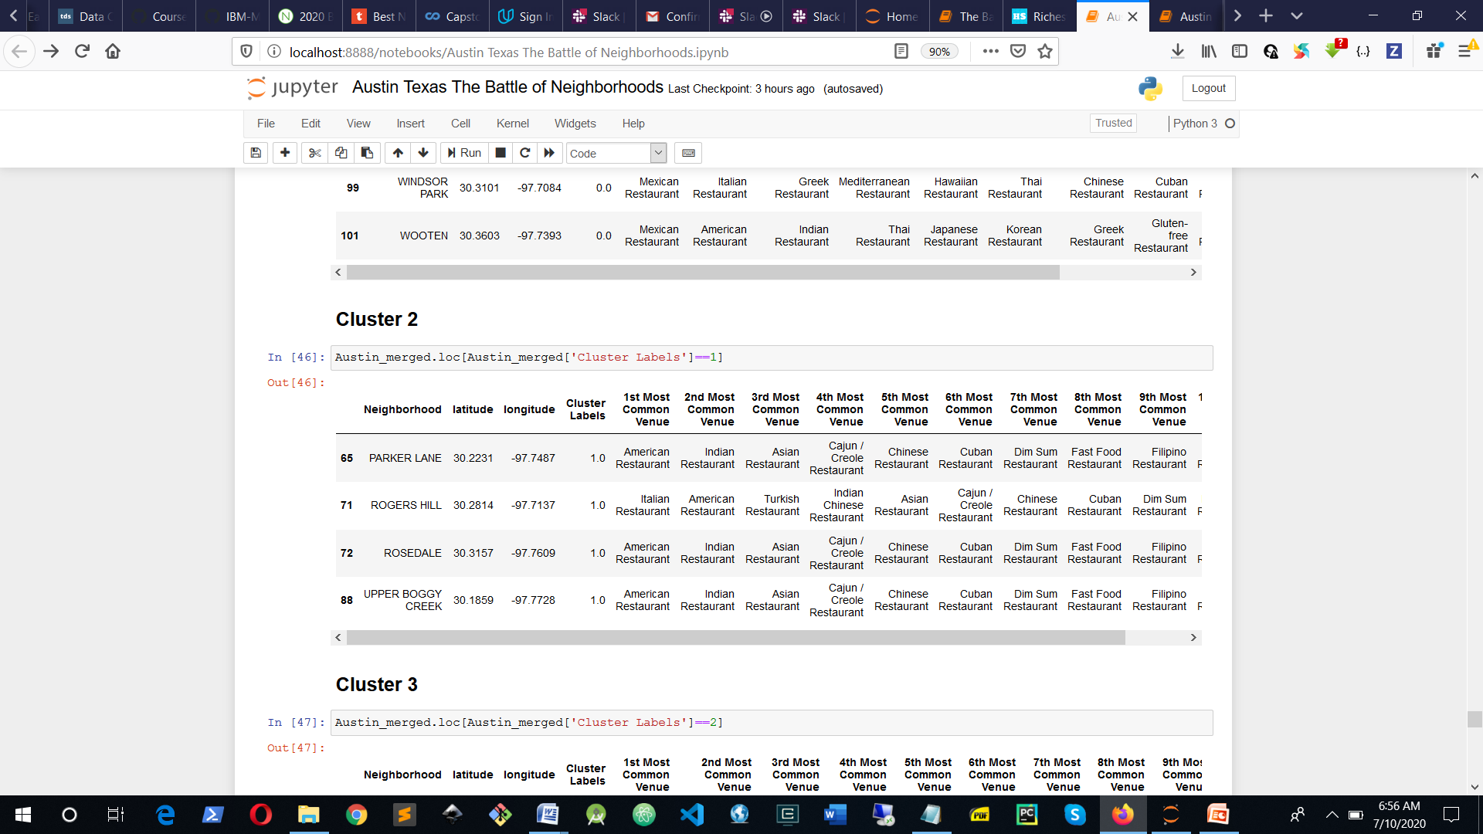

Slide 36
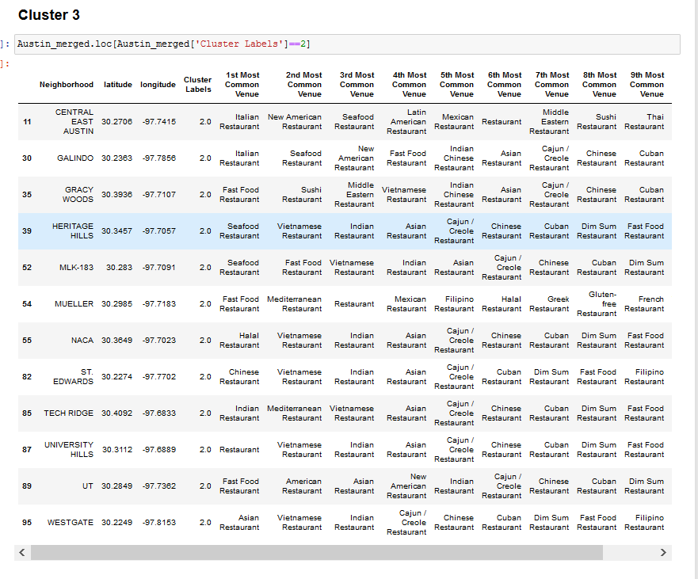

Slide 37
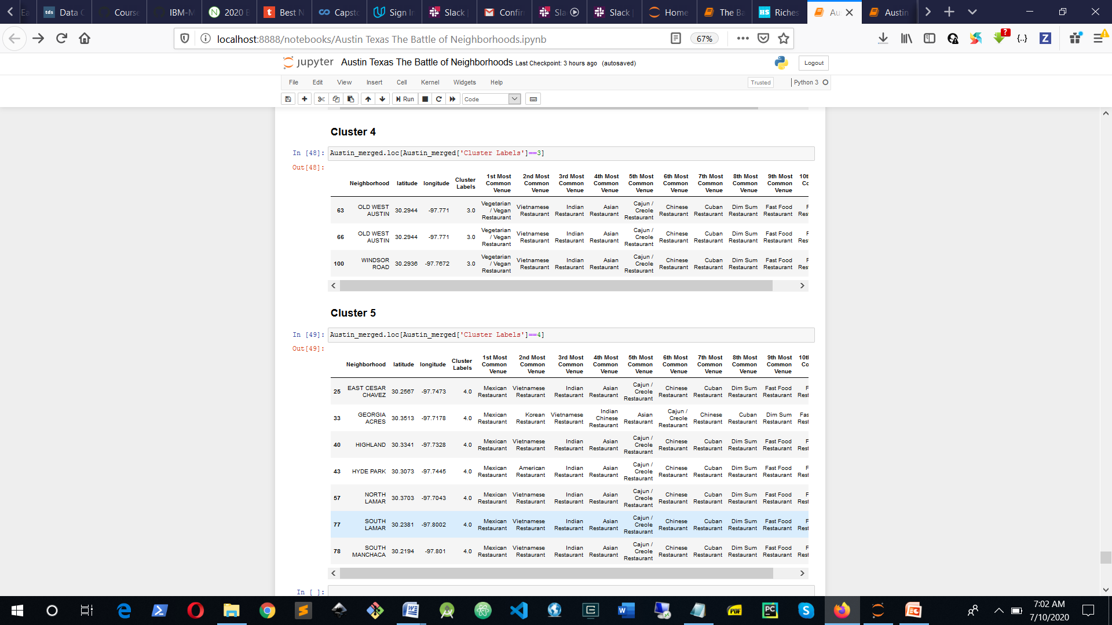

Slide 38
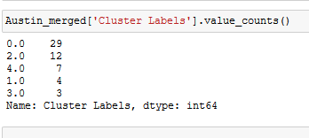
Determine Number of Neighborhoods per Cluster

Slide 39
Project Result
The above analysis shows that Cluster 1 has a high concentration of neighborhoods where the restaurant business thrives with Mexican restaurants dominant, closely followed by American restaurant, Cluster 3 has next higher density of neighborhoods with thriving restaurants, and interestingly Cluster 3 has a better blend of restaurant types than Cluster 1.

Slide 40
Project Result
Cluster 5 has a fair share of neighborhoods with restaurants, it can be conviniently be called 'The Mexican Restaurant Cluster' as practically all the neighborhood have Mexican restaurants as the first most common restaurant, closely followed by vietnamese restaurants. Clusters 2 and 4 seem to lag behind in the number of neighborhoods with 4 and 2 neighborhoods respectively.

Slide 41
Discussion
The above results have far-reaching implications; Cluster 1 with the highest number of neighborhoods with restaurants coincidentally happens to inhabit about 80% of the richest neighborhoods in Austin. Neighborhoods like Downtown with a median household income of $98,49; South River City with a median household income of $83,666; Barton Hill with median household income of $72,514 just to mention a few. Locating a restaurant in this cluster will be precarious, not only will the potential investor face stiff competition from the already saturated environment but also such an investor must have deep pockets.

Slide 42
Discussion
Clusters 3 and 5 provide better promises than cluster 1 for potential investors particularly because they proffer lesser density of neighborhoods with restaurants, though they are also inhabited by high profile neighborhoods such as East Cesar Chavez and South lamar in Cluster 5 with a median household income of $62,881 and $54,142 respectively; Galindo and Central East Austin neighborhoods in Cluster 3 with a median household income of $53,509 and $54,415 respectively. An investor wishng to site a new restaurant in cluster 5 is very likely to face stiff competion if the restaurant type is Mexican or even Vietnamese. The most common anology in the Cluster dataframes is a useful guide in this respect.
Of all the clusters, cluster 3 is best suited for potential investors for several reasons, firstly it consists of neighborhoods of the median

Slide 43
Discussion
household income class who can afford services of restarants without being too expensive, secondly, the cluster consists of neighborhoods of moderate density that can accomodate new entrants to the industry, and thirdly there is a good blend of restaurant types in the cluster providing an environment that can accommodate almost any restaurant type.
An investor investing in clusters 2 and 4 may experience lower patronage than in the other clusters, however these neighborhoods may be suitable for startups who may not be not be able to weather the storm of competition.

Slide 44
Discussion
Of all the clusters, cluster 3 is best suited for potential investors for several reasons, firstly it consists of neighborhoods of the median household income class who can afford services of restarants without being too expensive, secondly, the cluster consists of neighborhoods of moderate density that can accomodate new entrants to the industry, and thirdly there is a good blend of restaurant types in the cluster providing an environment that can accommodate almost any restaurant type.
An investor investing in clusters 2 and 4 may experience lower patronage than in the other clusters, however these neighborhoods may be suitable for startups who may not be not be able to weather the storm of competition.
Seasoned investors who are competition savvy and have deep pockets can still make tremendous in-roadsin Cluster 1
This project has some limitations particularly in sourcing recent datasets dealing with neighborhoods in Austin, such data as the average cost of housing units per neighborhood, the average rent per neighborhood, the crime rate per neighborhood and demographic data such as number family households per neighborhood, gender distribution, age distribution. Where some of these datasets are available they are not recent and often expressed per zipcode rather than per neighborhood names that are readily understandable to the average user.
We wish to recommend that data scientist take the limitations expressed here as a challenge and fill up the gap, we also wish to recommend to organizations engaging in dataset design and development to consider expressing datasets per neighborhood in addition to per zipcode

Slide 45
Discussion
Seasoned investors who are competition savvy and have deep pockets can still make tremendous in-roadsin Cluster 1
This project has some limitations particularly in sourcing recent datasets dealing with neighborhoods in Austin, such data as the average cost of housing units per neighborhood, the average rent per neighborhood, the crime rate per neighborhood and demographic data such as number family households per neighborhood, gender distribution, age distribution. Where some of these datasets are available they are not recent and often expressed per zip code rather than per neighborhood names that are readily understandable to the average user.

Slide 46
Discussion
I wish to recommend that data scientist take the limitations expressed here as a challenge and fill up the gap, we also wish to recommend to organizations engaging in dataset design and development to consider expressing datasets per neighborhood in addition to per zipcode

Slide 47
Conclusion
This project is a veritable tool to guide investors in the restaurant, despite the limitations described in the last paragraph, its efficacy as a guide to potential invetors cannot be undermined. This project is a work in progress and we intend to make it more robust in the very near future.

Slide 48
Reference
References
Jimmy Im, These are the 10 best places to live in the US in 2019, [online], Published Mon, Apr 15 20193:34 PM EDT Updated Mon, Apr 29 201912:42 PM EDT https://www.cnbc.com/2019/04/15/us-news-world-report-best-places-to-live-in-the-us-in-2019.html
Chris Kolmar, Richest Neighborhoods In Austin, TX For 2020, [online], January 12, 2020, https://www.homesnacks.net/richest-neighborhoods-in-austin-128966/

